Slide 1
Skills assaissement for the evaluation
Fundamental notions of chemistry in aqueous solution
Different types of reactions
EVALUATION:
Ability to “read” and analyze output file
Ability to represent any kind of solutions
Ability to study effect of a solid /gaz phase on a solution composition
Ability to study reaction with a solution

Slide 2
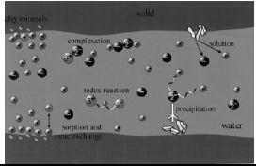
Type of reaction: K
Solution
Redox reaction K
Complex formation K
Interface solid/solution
Sorption
Kd sorption coefficient
Ion exchange
Kx selectivity coeffixient
Solid
Dissolution/precipitation
Ks solubility-product

Slide 3
Redox reaction
Can be characterized by oxygen or electron transfer
The equilibrium redox potential can be calculated from Nernst Equation
PHREEQC: pe is used instead of E_{H} :

Slide 4
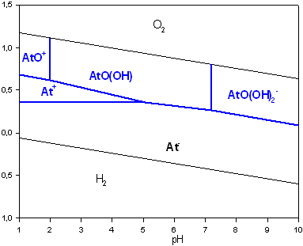
Pourbaix diagramme of astatine At

Slide 5
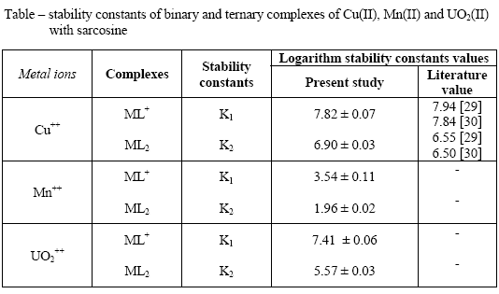
Complexe formation
A complex= a coordination compound of a positively charged part (a metal) with a negatively part, the ligand.
Notes:
It is observed from the data in the table that the order of stability constants viz,
copper(II) > uranyl(II) > manganese(II)
are same for 1:1 and 1:2 binary complexes. This order of stability constant values find support from the work of Irving and Williams ^{[27]}. The stability of binary complexes follow the order
log K₁ > log K₂

Slide 6
Different ways to describe a Solution
The aqueous concentrations in a solution are defined with SOLUTION. The symbols for the elements are listed in the first column of SOLUTION_MASTER_SPECIES in the database.
Ex: phreeqc.dat (opening database using WordPad program)
SOLUTION_MASTER_SPECIES
#
#element species alk gfw_formula element_gfw
#
H H+ -1.0 H 1.008
H(0) H2 0.0 H
H(1) H+ -1.0 0.0
E e- 0.0 0.0 0.0
O H2O 0.0 O 16.0
O(0) O2 0.0 O
O(-2) H2O 0.0 0.0
Ca Ca+2 0.0 Ca 40.08
Mg Mg+2 0.0 Mg 24.312
Na Na+ 0.0 Na 22.9898
K K+ 0.0 K 39.102
Fe Fe+2 0.0 Fe 55.847
Fe(+2) Fe+2 0.0 Fe
Fe(+3) Fe+3 -2.0 Fe

Slide 7
Solution - example 1
Speciates an analysis, calculate saturation indices
SOLUTION 1
temp 25. # temperature in degrees Celcius, default = 25 C
pH 7.0 # default pH = 7.
pe 4.0 # pe = -log(electron activity), default = 4.
-units mmol/kgw # default units mmol/kg water
Ca 3.0 # total dissolved Ca
Na 1.0
Alkalinity 3.8 # mmol charge / kgw
S 1.0 # total sulfur, mainly sulfate, S(6), at pe = 4
N(5) 0.2 # nitrogen in the form of nitrate, N(5)
Cl 1.0
water 1 # kg water, default = 1 kg
density 1 # density, default = 1 kg/L
END

Slide 8
Solution - example 2
define range of solution #'s, and use mg/L units
SOLUTION 2-4 # solutions 2, 3 and 4 -units mg/l
Ca 40 # mol. weights listed under SOLUTION_MASTER_SPECIES
Alkalinity 122 as HCO3 # HCO3 is used for recalculating to mol charge
END

Slide 9
Solution - example 3
Adjust concentration or pH to charge balance
SOLUTION 4 # default pH = 7, temp = 25, -units mmol/kgw
Na 2.0
Cl 1.3 charge # adapt Cl to obtain charge balance
END
Notes:
RAJOUTER CHARGE UNBALANCED

Slide 10
Important TIPS:
END is the signal for PHREEQC to calculate the composition of the solution and the reactants in what is termed a simulation.
The compositions can be stored in computer memory with SAVE solution m, SAVE exchange m, etc., to be used later on in the same computer run (the same input file) with MIX or USE solution m, USE exchange m, etc.
where m is a number or a range of numbers.

Slide 11
Type of reaction: K
Solution
Redox reaction K
Complex formation K
Interface solid/solution
Sorption
Kd sorption coefficient
Ion exchange
Kx selectivity coeffixient
Solid
Dissolution/precipitation
Ks solubility-product

Slide 12
K_{T}: Reaction of solubility
Definition: Solubility is the property of a solid, liquid, or gaseous chemical substance called solute to dissolve in a solid, liquid, or gaseous solvent to form a homogeneous solution of the solute in the solvent.
SI= saturation indice= Log IAP-Log K_{T}
If SI>0 supersaturated
If SI<0 under saturated

Slide 13
Mineral Equilibration-Exemple
# Example 1. Equilibrate water with calcite and CO2
#
SOLUTION 1 # default pH = 7, pe = 4, temp = 25, units = mmol/kgw
Ca 3.0
Alkalinity 4.0
S(6) 1.0
EQUILIBRIUM_PHASES 1
Calcite 0.0 10.0 # Mineral from database, SI = 0.0, amount = 10 mol
CO2(g) -2.0 # SI = - 2.0 or [P_CO2] = 10^-2.0, amount = 10 mol
END

Slide 14
REACTION
The keyword REACTION is used to stepwise add reactants or amounts of minerals to the solution.
Ex: gypsum

Slide 15
REACTION - example 1
# Add 5 and 10 mmol NaCl to 1 liter distilled water.
SOLUTION 1 # Define start solution, just water
REACTION 1
NaCl 1.1 # Reactant formula, stoichiometric coefficient in the reaction
5e-3 10e-3 # Add 1.1*5e-3 mol NaCl and 1.1*10e-3 mol NaCl
# 10e-3 moles in 2 steps # alternate way of writing the steps
END

Slide 16
REACTION - example 2
Add Calcite and CO2 to water
SOLUTION 2
REACTION 2
Calcite 1.0 CO2(g) 1.3 # mineral from database, stoichiometric coefficient
2e-3 # Add 1*2e-3 = 2e-3 mol Calcite and 1.3*2e-3 = 2.6e-3 mol CO2
END

Slide 17
Exercise 2
Represent the following solution:
Temperature 25°C
pH=12
NaCl=0.1 mol/L
Add HCl 0.1 mol/L
What’s the final pH?

Slide 18
Exercise 3
Represent the following solution:
Temperature 25°C
pH=12
NaCl=0.1 mol/L
Add HCl 0.1mol/L in 30 steps
Represent the evolution of pH as a function of HCl concentration adding: excel file
What quantity of HCl is necessary to neutralyse solution 1?

